Slide 1
Anaesthestic Implications of PIH SAB/EDB/GA
Dr Suvarna. K
DA, MD, DNB, EDAIC
Additional Professor
Govt medical college- Calicut

Slide 2
Hypertensive Disorders - Pregnancy
Complicates 5-10% pregnancies
Leading cause of morbidity & mortality
Classification:
*ACOG Task Force 2013
1. Gestational hypertension- >20wks , no protenuria
2. Preeclampsia - >20wks with protenuria
- Mild
- Severe
3. Chronic hypertension
4. C/c hypertension with superimposed preeclampsia

Slide 3
Preeclampsia
Mild
Severe
SBP ≥ 140-160
DBP ≥ 90-110
Mild protenuria- 300mg in 24hr <5g/24hr
SBP ≥ 160, DBP ≥ 110
Protenuria ≥ 5g/24hr
Oliguria
Visual disturbances
Pulmonary edema
Thrombocytopenia
HELLP syndrome
Impaired LFT
Rt upper quadrant pain
IUGR

Slide 4
Risk factors
Pre-conceptional factors
c/c HTN, Renal disease
Diabetes
Obesity
Age > 40 yrs
Family H/o preeclampsia
Pregnancy related
Partner related
Multiple pregnancy Nulliparity
Hydrops
Limited sperm exposure
Fathered preeclamptic before

Slide 5
Aetiopathogenesis
Abnormal trophoblastic invasion
Immunological intolerance
Maladaptation to CV/inflamatory changes
Genenetic influences
Dietary deficiency

Slide 6
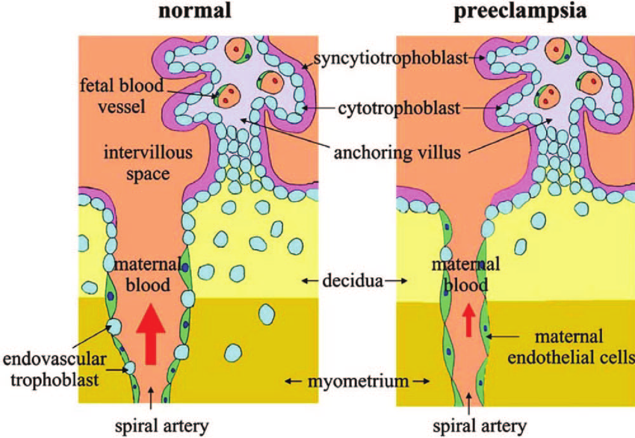
Abnormal placentation
Incomplete trophoblastic invasion
Narrowed spiral arteries
Placental Ischemia
VC mediators
Endothelial dysfunction

Slide 7
Immunological
Long term exposure to sperm antigens protective
Uterine NK cells influence trophoblastic invasion
Autoantibodies to Angiotensin-1 receptors
Reactive O₂ species
Block trophoblastic invasion

Slide 8
Antiangiogenic proteins
Soluble fms like Tyrosin kinase-1
Soluble endoglin
SFlt-1: PIGF ratio
Serum levels as predictors of preeclampsia

Slide 9
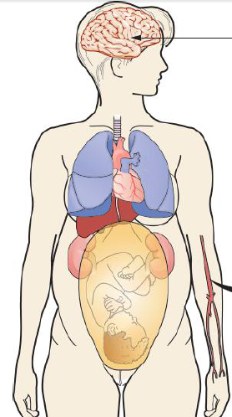
Pathophysiologic changes
Airway edema
Difficult airway
Headache
Visual disturbance
Ischemia, Edema
Eclampsia, Coma
Pulmonary edema
Vasospasm
↓ IV volume
Hypersensitivity to VC
↑SVR, LVH, LVF
Abnormal LFT
Subcapsular Hge
Rupture
Thrombocytopenia
DIC, HELLP
Placental ischemia
IUGR
Preterm delivery
Abruption
Protenuria, ↓GFR
Oliguria, Renal failure

Slide 10
Eclampsia
Seizure / unexplained coma in pre-eclampsia
No preexisting neurological disorder
High morbidity/mortality. MMR 4.2%
Seizures – Abrupt onset, self limiting

Slide 11
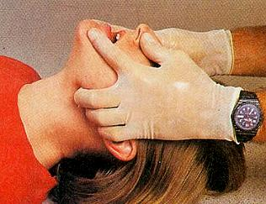
Management of Eclampsia …
A-B-C

Slide 12
Management of Eclampsia …
Control & prevention of further seizures
MgSO₄ - Zuspan regimen:
4-6 gm iv loading and 1-2gm/hr infusion
2gm iv repeat bolus
Control of HTN:
Labetelol – 20-40 mg iv every 5-10min
Hydralazine – 5-10mg iv every 15-20min
Vasodilators – NTG, SNP
Delivery
* Magpie trial.Lancet 2002,359;1877-90

Slide 13
Magnesium sulphate therapy…
Narrow therapeutic range
Monitor RR, urine output and DTR
Monitor serum levels if renal dysfunction
Calcium gluconate 10% , 1gm for toxicity

Slide 14
Recurrent seizures…
Benzodiazepines- Midazolam 1-2mg or
- Diazepam 10mg iv
Phenytoin 15mg/kg iv
Thiopentone sodium 50-100mg
Muscle relaxants & IPPV

Slide 15
Anaesthetic Management

Slide 16
Preanaesthetic evaluation
Maternal hemodynamics
Airway examination
Coagulation status
Fluid balance
Systemic evaluation
Investigations:
Complete hemogram
Coagulation profile
LFT, RFT

Slide 17
Labor Analgesia
Epidural analgesia preferred
Early catheter placement recommended
Excellent pain relief
Reduce circulating catecholamines
Improves intervillous blood flow
Improving BP control
Effective anaesthesia & postop analgesia if CS

Slide 18
Anaesthesia for Caesarean
Neuraxial anaesthesia is preferred – (Level 1)
Spinal, Epidural or CSE
Choice of anaesthesia depends on
- Coagulopathy
- Pulmonary edema
- Cardiac/Renal/hepatic dysfunction
- Eclampsia
* ACOG Practice Bulletin No. 33
* ASA Task Force on Obstetric Anesthesia. Practice guidelines. Anesthesiology 2007; 106:843–63

Slide 19
Advantages of Regional
Major advantage - Avoidance of GA
Leading cause of death in PE – IC Bleeding (CEMACH 2003-05)
Difficult airway
Hypertensive response to intubation
Cerebral hemorrhage
Pulmonary edema
Impairs uteroplacental blood flow

Slide 20
Advantages of RA…
Aspiration risk less
No neonatal depression
Drug interaction less- MgSO4
Maintenance of utero-placental perfusion
Excellent postop analgesia
Delayed recovery in GA-Prolonged action of drugs
Better bonding with mother & baby

Slide 21
Disadvantages of Regional
Hemodynamic instability
Risk of hematoma

Slide 22
CNB in PE - Hemodynamics
Less severe hypotension
Hypotension short lived and easily treated
No adverse neonatal effects
No clinically significant outcome differences
Epidural was favored traditionally

Slide 23
Spinal vs Epidural
Spinal
Epidural
Simplicity
Small drug dose
Rapid onset
Excellent relaxation
Low failure rate
Hypotension
Duration - short
Stable hemodynamics
Prolonged analgesia
Slow onset
High failure rate
Hematoma risk more
Technical difficulty

Slide 24
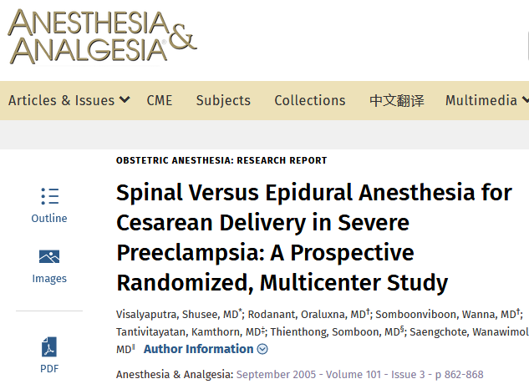
No clinically significant difference in hypotension
No adverse neonatal outcome
Support spinal anesthesia for cesarean in severely
preeclamptic patients

Slide 25
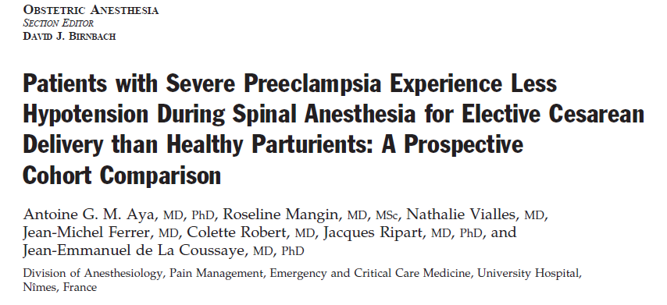
Less frequent hypotension which was less
severe and required less ephedrine

Slide 26
Severe PE with HELLP
Safe to do if count > 75000 – 80000 /mm³
Contraindicated if < 50000 /mm³
50-75000 – Individualized decision
Trend in platelet count more important
Document the recent value (1-3hr)
Safe level of platelet count?

Slide 27
CNB and Coagulopathy…
Most skilled Anaesthesia provider must do CNB
Spinal may be preferred
Epidural catheter removal – when platelet normal
Monitor postoperatively – Neurological signs
Hematoma - Imaging and prompt intervention

Slide 28
General Anaesthesia
GA
Patient refusal
Ongoing seizures
Abnormal coagulation
APH
↑ICP
FND
Pulmonary edema
Emergency

Slide 29
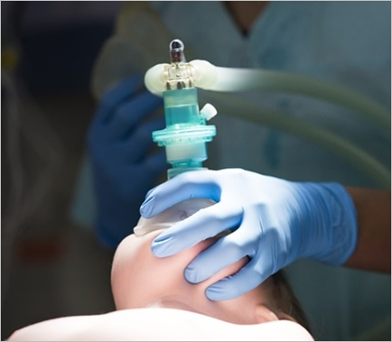
Anaesthetic concerns of GA
Difficult airway
Exaggerated hypertensive response
MgSO₄ – Drug interactions

Slide 30
Airway in Preeclampsia
Exaggerated pharyngolaryngeal edema
Capillary engorgement - Easily traumatized
Weight gain and large breasts
Increased Mallampati score
Higher Incidence of Difficult/Failed Intubation

Slide 31
General Anaesthesia in PE
Rapid sequence induction
Difficult airway cart and expert help – must
Minimize hypertensive response to intubation
Labetalol: 10 mg boluses
Esmolol: 2mg/kg iv
Remifentanyl: 1mcg/kg iv
Fentanyl: 1-3 mcg/kg iv
NTG: 1.5- 2.5 mcg/kg iv

Slide 32
General Anaesthesia in PE…
NDMR - Titrated doses
- Neuromuscular monitoring ideal
Neonatal resuscitation team
Uterine atony and PPH
Hypertensive response to extubation

Slide 33
Regional or GA ?
Neuraxial anesthetic techniques, when
feasible, are strongly preferred to GA for
preeclamptic parturients
* ACOG Practice Bulletin No. 33. Obstet Gynecol 2002;99:159–67
* ASA Task Force on Obstetric Anesthesia. Practice guidelines. Anesthesiology 2007; 106:843–63

Slide 34
Anaesthetic Managent of CS
Tailored to individual patient
GA
RA

Slide 35
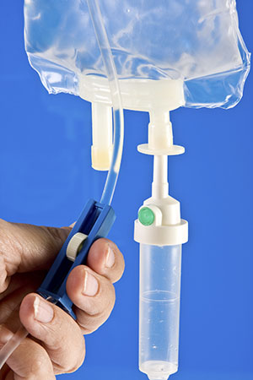
Fluid management
Risk of pulmonary edema
Leaky capillaries & low colloid oncotic pressure
LV dysfunction
Contracted IV volume
Restricted fluids: 75-100 ml/hr (1-2ml/kg/hr)
Urine output adequate 0.5ml/kg/hr
No benefit of colloids
* Joy et al. UpToDate Sept 2019

Slide 36
Fluid management in Oliguria
Oliguria – Pre-renal , renal or both
Fluid challenge of 250 ml crystalloid
Further fluid challenge - if responds
Invasive monitoring if persistent oliguria
Avoid CVP above 4-5 mm of Hg
PCWP-CVP difference more in preeclampsia

Slide 37
Invasive monitoring ???
Indications same as in other conditions
No RCTs support use of CVC in all - Complications
CVP poorly correlate with PCWP
PCWP better for preload measurement
TTE recommended if acute hemodynamic complications
* Li YH et al. Cochrane Database-Syst Rev 2012.CD 00882
⃰ Current Opinion in Anesthesiology 2005; 28: 254-250

Slide 38
Invasive BP monitoring ???
Persistent, severe hypertension
Use of vasoactive infusions
Blood gas analysis –pulmonary edema, hypoxia
Minimally invasive cardiac output monitor

Slide 39
Postoperative management
Close monitoring in HDU
Risk of complications continue
MgSO₄ for 24 hrs
Thromboprophylaxis
Continue antihypertensives
Restricted fluid management

Slide 40
Summary
Leading cause of maternal morbidity and mortality
Anaesthetic concerns- Airway, hemodynamics & coagulation abnormalities
CNB is preferred for CS if possible
GA- minimize stress response
Vigilant monitoring & Restricted fluid therapy

Slide 41
Summary…
Careful pre-anaesthetic evaluation, individualized anaesthetic plan and vigilant monitoring are essential
Anaesthetic plan in the best interest of safety of mother and baby

Slide 42
Conclusion
As a part of multidisciplinary team, we are responsible for providing SAFE
Analagesia
Anaesthesia
Critical care and resuscitation
Optimizing outcome of mother and baby

Slide 43
Thank you

Slide 45
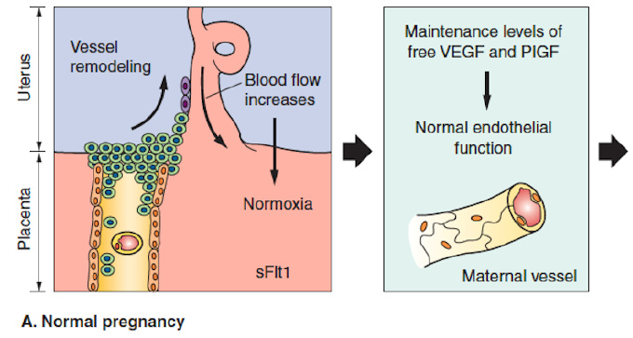
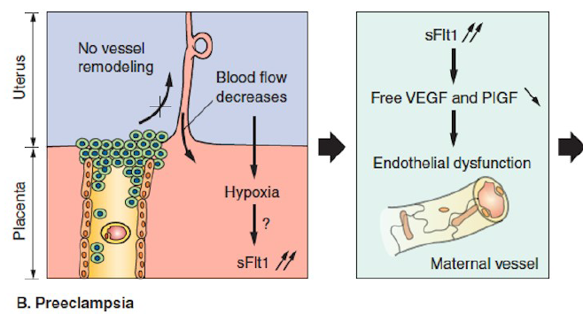
Normal organ function
Multi-organ disease

Slide 46
Prevention of Preeclampsia
Low dose Aspirin
Calcium supplementation
Antioxidants - Vitamin C, E
Low-dose (81 mg/ day) aspirin prophylaxis(ASPRE Trial)
If one high-risk factors or > one moderate-risk factors

Slide 47
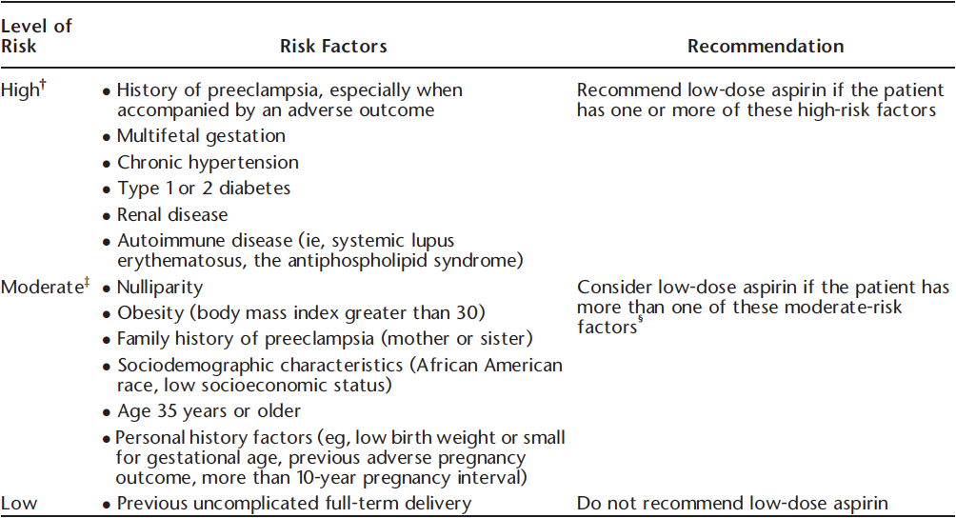

Slide 48
Acute severe hypertension

Slide 49
Treatment of Preeclampsia
Definitive - delivery of fetus & placenta
Control of Hypertension
Optimization of IV volume
Prevention of seizures

